Slide 1
Scaled Agile Survey
Findings & Recommendations
What the data tells us — and what to do about it
4.13
2.67
1.46 pts
Team
Implementation
(Best score)
Competitive
Position
(Worst score)
Gap between
best & worst

Slide 2
The Central Finding: A Clear Paradox
Teams are executing well — but business outcomes are not materialising
"Organisations are running Scaled Agile practices well — but they are not achieving strong business outcomes."
4.13
3.67
2.83
1.46
Team Implementation
(highest score)
Portfolio & ART
(middle layer)
Enterprise Success
(lowest section)
Point gap — best
vs worst metric
Reason 1
Reason 2
Reason 3
Measurement Disconnect
ART Layer Bottleneck
Outcomes Defined Too Broadly
Teams track velocity & deployments. Business leaders track revenue & market share. These systems are not connected — neither side knows if the other is succeeding.
ART Importance is the lowest practice score (3.58) with the most disagreement (Std Dev 0.94). Ceremonies run by compliance, not conviction, add overhead without value.
Success metrics like Competitive Position and Investor Confidence take years to appear. Teams cannot see the link between their daily work and these lagging indicators.
DANA8411 | Scaled Agile Survey | Findings & Recommendations

Slide 3
The Three-Layer Model
Strength at the bottom is not flowing upward into business value
LAYER 3 — BUSINESS OUTCOMES
2.67 – 3.01
Enterprise, Programme & Customer Success (Q12–Q14). Not achieving market, investor, or customer wins. The weakest part of the entire survey.
WEAK
LAYER 2 — COORDINATION
3.58 – 3.67
ART & Portfolio level (Q6, Q7, Q9, Q10). Framework is running but not fully trusted. Highest disagreement across all sections.
MIXED
LAYER 1 — TEAM EXECUTION
4.04 – 4.13
Team level (Q8, Q11). Teams deliver, test, build, and define extremely well. The organisation's greatest asset — but it must connect upward.
STRONG
DANA8411 | Scaled Agile Survey | Findings & Recommendations

Slide 4
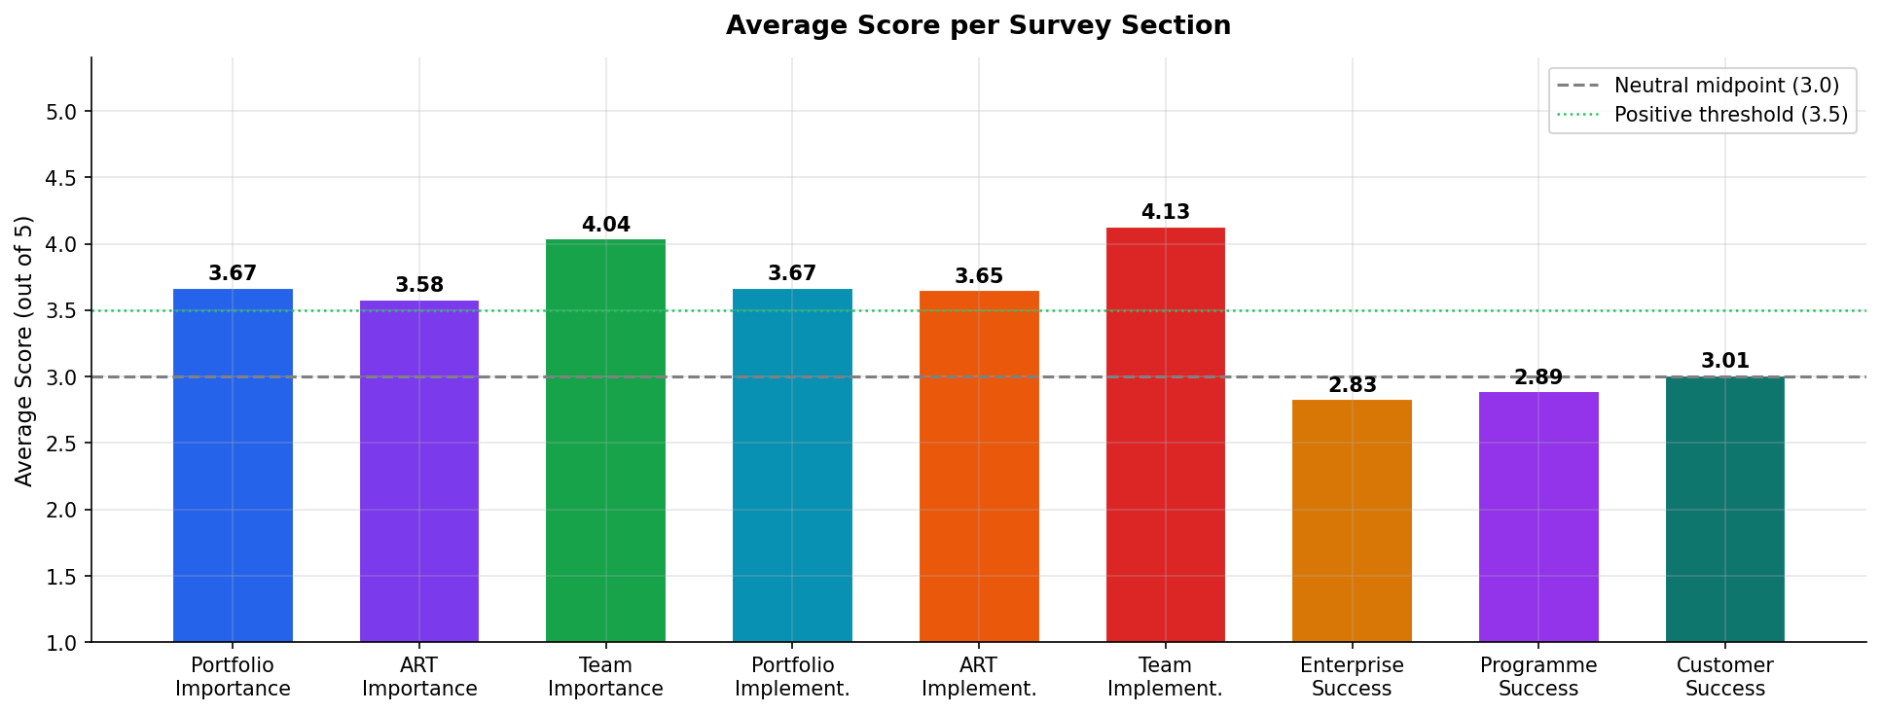
Section Scores at a Glance
Six practice sections score well above neutral — three success sections do not
DANA8411 | Scaled Agile Survey | Findings & Recommendations

Slide 5
Recommendation 1 — Connect Team Metrics to Business Outcomes
R1
Connect Team Metrics to Business Outcomes
Evidence from data: Team Implementation (4.13) vs Enterprise Success (2.83) — 1.46 point gap; practitioners could not answer outcome questions
Introduce OKRs at team level
Run the "So What?" exercise
Replace "complete 40 story points" with outcome-driven goals: "reduce customer complaint rate by 15% this quarter." Link every sprint goal to a business metric.
For every feature delivered, ask "so what does this mean for the customer?" repeatedly until you reach a measurable business outcome. Make this a team ritual.
Make business metrics visible in team spaces
Quarterly business outcome reviews
Display customer NPS, satisfaction scores, and revenue attribution on team dashboards alongside velocity. Teams need to see the scoreboard they are playing for.
Each quarter, teams present not just what they built but what business impact it had. Creates accountability for outcomes, not just outputs.
DANA8411 | Scaled Agile Survey | Findings & Recommendations

Slide 6
Recommendation 2 — Fix the ART Coordination Layer
R2
Fix the ART Coordination Layer
Evidence from data: ART Importance lowest of all practice sections (3.58); highest disagreement (Std Dev 0.94); implementation exceeds importance — compliance without conviction
PI Planning retrospective
Reconnect ceremonies to purpose
Ask: "What decisions did PI Planning enable that we could not have made without it?" If teams struggle to answer, the ceremony is not working as intended.
Run ART-level workshops focused on the *outcome* of each ceremony, not the mechanics. A System Demo is not about showing work — it is about getting integrated feedback.
Right-size the ART
Empower Release Train Engineers
More than 8–12 teams makes ceremonies overwhelming. Fewer than 3–4 makes them redundant. Review whether ART boundaries reflect genuine value stream dependencies.
Give RTEs explicit authority to cancel or simplify ceremonies not adding value. RTEs should be coaches, not ceremony administrators enforcing compliance.
DANA8411 | Scaled Agile Survey | Findings & Recommendations

Slide 7
Recommendation 3 — Strengthen the Portfolio-to-Outcome Connection
R3
Strengthen the Portfolio-to-Outcome Connection
Evidence from data: Portfolio scores healthy (3.67) but Enterprise Success weak (2.83); Benefit Alignment scored only 2.75
Implement LPM outcome metrics
Build a Benefits Realisation Register
Track: time from strategic initiative to first customer value; % of budget on measurable outcomes vs "keep the lights on"; benefits realisation rate per approved epic.
A living document tracking every portfolio investment and recording whether expected benefits were achieved at 3, 6, and 12 months. Most organisations do not have this — its absence is why Benefit Align scored 2.75.
Monthly portfolio review checkpoints
Connect portfolio themes to team OKRs
Replace annual or quarterly portfolio reviews with monthly checkpoints. Tightening the feedback loop between investment decisions and observed outcomes closes the value gap faster.
Each strategic theme at portfolio level should map directly to OKRs at the ART and team level. If a team cannot name which portfolio theme their current work supports, the connection is broken.
DANA8411 | Scaled Agile Survey | Findings & Recommendations

Slide 8
Recommendation 4 — Build a Line of Sight from Team to Market
R4
Build a Line of Sight from Team Work to Market Results
Evidence from data: Bottom 5 scores are all external metrics: Competitive (2.67), Investor (2.68), Market Impact (2.77) — practitioners cannot see these
Introduce Feature Metrics
Customer Advisory Boards with delivery members
For every significant feature, define in advance: "How will we know this feature succeeded?" Measure it 4–8 weeks after release. Share results with the team that built it.
Include developers, not just executives. When engineers hear from customers directly, prioritisation improves and the connection between daily work and user impact becomes real.
Monthly market feedback brief
"Translation sessions" with business leaders
Distribute a brief to all ART members showing competitive, customer, and market metrics. Teams do not need to own these metrics — they need to know they exist and see them change.
Finance and compliance leaders explain to delivery teams how their work affects regulatory standing or investor confidence. Builds empathy and shared language across layers.
DANA8411 | Scaled Agile Survey | Findings & Recommendations

Slide 9
Recommendations 5 & 6
Fix the customer acceptance gap and create a unified outcomes dashboard
R5
R6
Fix the Customer Acceptance Gap
Create a Unified Outcomes Dashboard
Evidence: Delivery scores 3.25 but Customer Acceptance only 2.90 — products shipped but not fully accepted
Evidence: Visibility gap in missing values; all success sections at or below neutral; no shared measurement system
Implement BDD / Example Mapping so "done" is defined as a customer-agreed test before development starts
Team layer
Deployment frequency, lead time, defect rate
Hold regular customer demos (not just internal System Demos) to catch misalignment early
ART layer
PI objectives met, feature delivery rate, programme predictability
Add Customer Acceptance Rate as a first-class metric alongside velocity
Portfolio layer
Strategic themes funded vs delivered, benefits realisation progress
Update the Definition of Done to explicitly require customer validation, not just technical completion
Business layer
Customer NPS, market share trend, revenue from new features
DANA8411 | Scaled Agile Survey | Findings & Recommendations

Slide 10
Priority Action Plan
Where to start — ranked by data evidence and expected impact
#
Priority
Action
Data Evidence
Expected Impact
1
HIGHEST
Connect team OKRs to business outcomes
Practice-outcome gap (1.46 pts)
Teams measure impact, not just output
2
HIGH
Build unified outcomes dashboard
Visibility gap; missing values in Q13/Q14
Better decisions; practitioners can answer outcome Qs
3
HIGH
Fix customer acceptance (BDD/Example Mapping)
Delivery 3.25 vs Acceptance 2.90
Reduces "shipped but not accepted" failures
4
MEDIUM
Reinvigorate ART ceremonies
ART Importance 3.58, Std Dev 0.94
Regain conviction in the coordination layer
5
MEDIUM
Implement Benefits Realisation Register
Benefit Align lowest in Q12 at 2.75
Portfolio-level outcome accountability
6
MEDIUM
Market feedback loop to delivery teams
Competitive 2.67; Market Impact 2.77
Closes visibility gap between teams and market
7
ONGOING
Protect team-level practices
Team Implementation already strong at 4.13
Prevent regression of the biggest asset
DANA8411 | Scaled Agile Survey | Findings & Recommendations

Slide 11
What is Working vs What Needs Improvement
A balanced assessment of the organisation's current state
✓ What is Working Well
✗ What Needs Improvement
Team delivery practices are strong and trusted (4.0–4.13)
Business outcomes not yet materialising (2.67–3.01)
Importance & implementation are perfectly aligned — no commitment gap
Practitioners cannot see the connection between work and results
All 6 practice sections sit above the positive threshold (3.5+)
All 3 success sections at or below neutral (3.0)
Team practices show the most consensus (lowest Std Dev in the survey)
ART-level practices show the most disagreement — mixed buy-in
Success dimensions are holistic and linked (r = 0.85 Enterprise ↔ Programme)
External metrics (Competitive, Investor, Regulator) are weakest of all
No negative correlations anywhere — practices reinforce each other
Products delivered but not always accepted — acceptance gap exists
DANA8411 | Scaled Agile Survey | Findings & Recommendations

Slide 12
C O N C L U S I O N
The engine is running.
Now steer it toward results.
The Scaled Agile engine is running — team practices are strong, committed, and consistent
Business outcomes (competitive position, investor value, customer acceptance) are not yet materialising
The problem is NOT effort or belief — importance and implementation are perfectly aligned
The missing ingredient is a clear, measured link between what teams deliver and what the business achieves
Six recommendations — prioritised by data evidence — provide the roadmap from operational excellence to business value.
DANA8411 · Scaled Agile Survey · Findings & Recommendations

